Slide 1
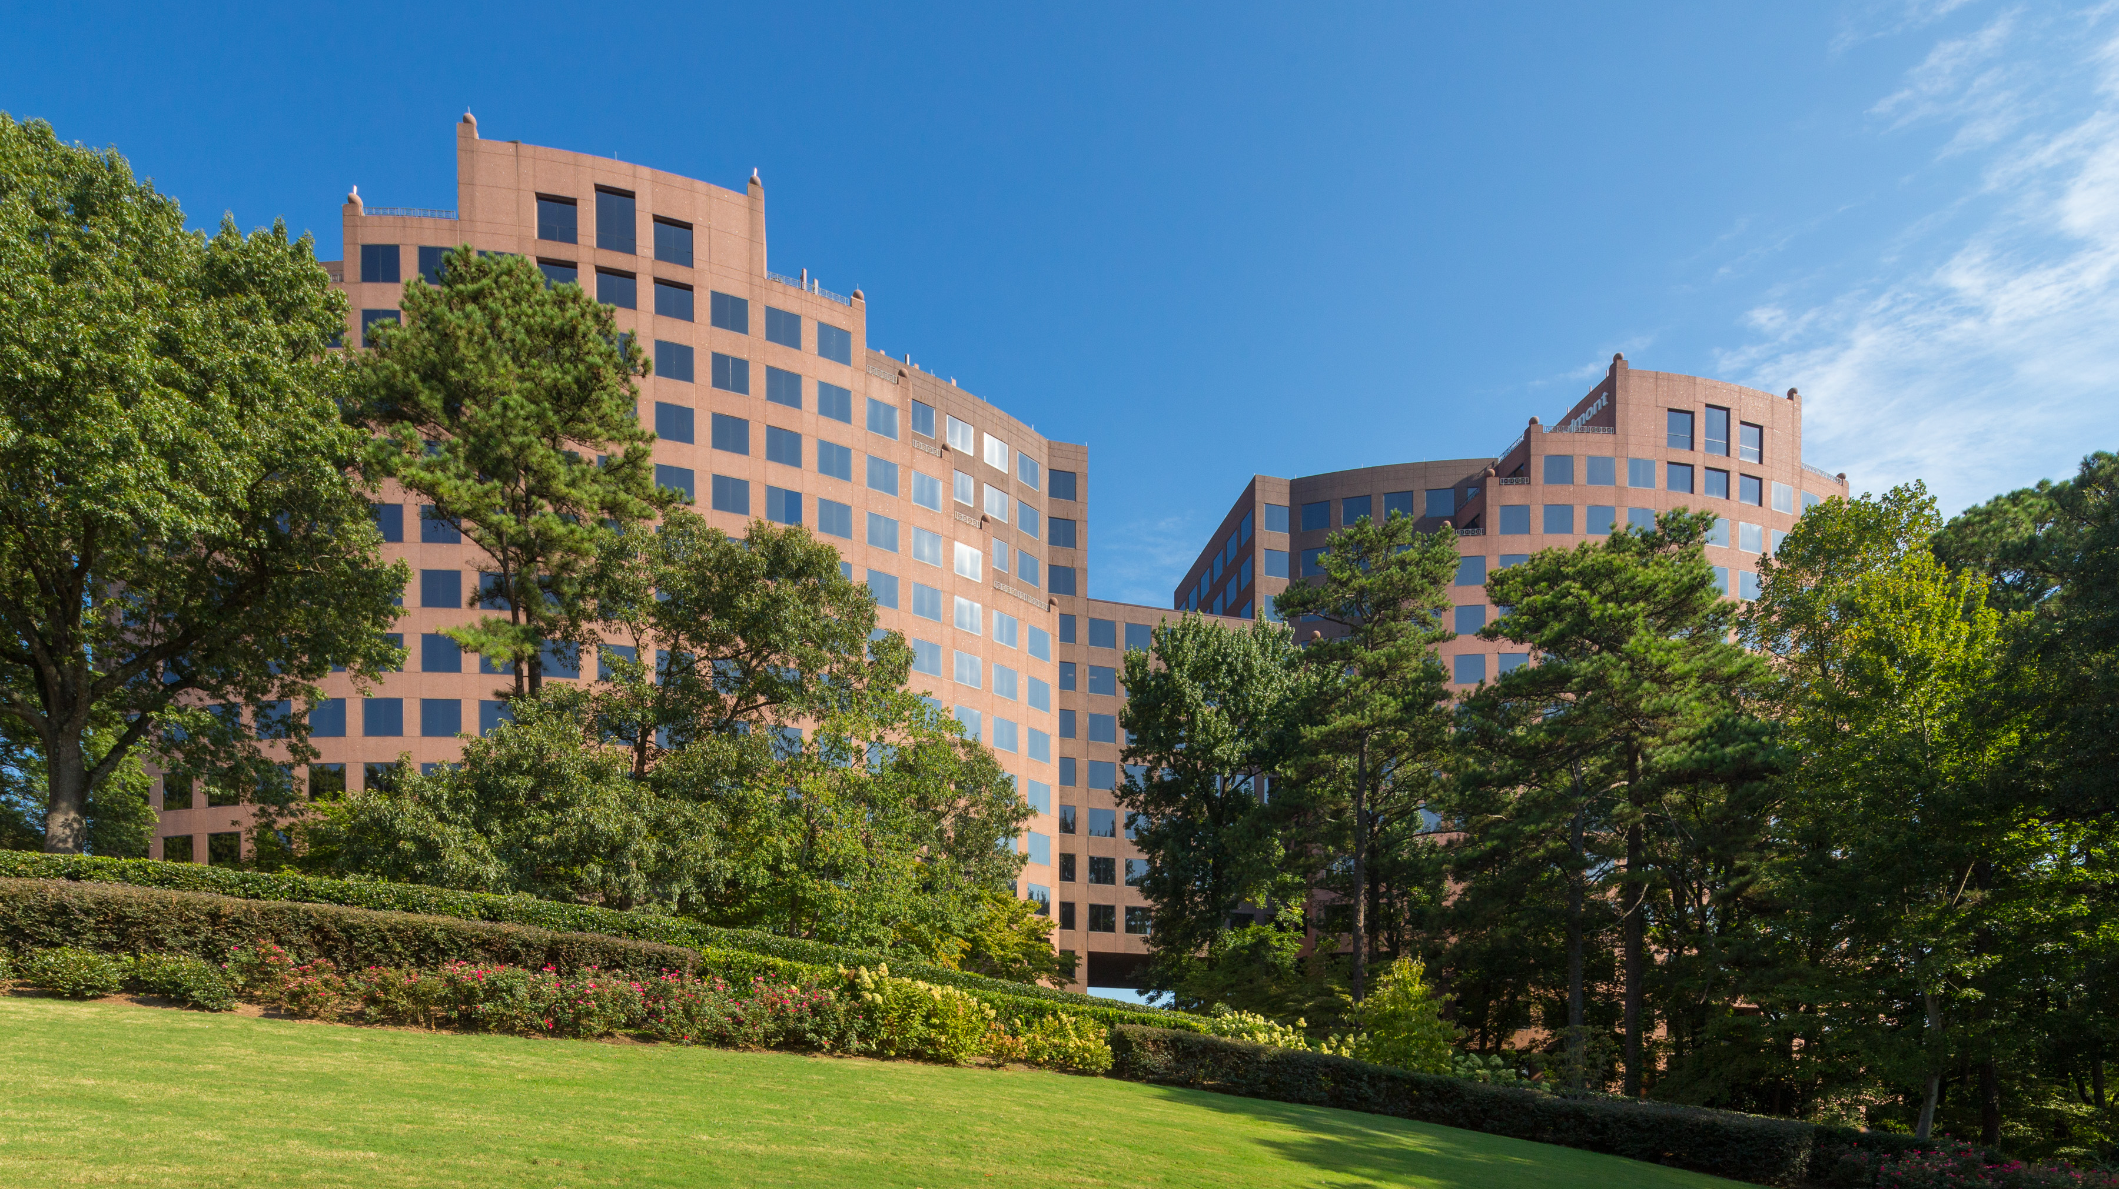
PACES WEST Sustainability

Slide 2
TWO EASY STEPS… Step 1: Mix all RECYCLABLES in your Desk-Side Container
Paces West Recycling Program
RECYCLABLES – CLEAR TRASH BAG
Office Paper – All Colors
Envelopes – Windows and Labeled
Junk Mail, Magazines, & Newspaper
Cardboard
Phone Books
Soft & Hard Cover Books
File Folders
Brochures and Reams
Wrapping Paper and Greeting Cards
Aluminum Cans (Soda Cans)
Tin, Steel, & Metal Cans
Lids from Jars
Frozen Food Packages
Carton Boards (Cereal, Juice, or Shoe Boxes)
Paper Grocery Bags and Shredded Paper
All Plastic Containers with Recyclable Symbol
Glass Containers
Empty Aerosol Cans
Please remember to rinse out any food or liquid residue from recyclable containers.

Slide 3
TWO EASY STEPS… Step 2: Take ALL Food Waste (NON-RECYCLABLES) to Break Room
Paces West Recycling Program
NON-RECYCLABLES – BLACK TRASH BAGS
Styrofoam cups if they do not have a recycling symbol
Wax Coated Coffee Cups (Starbucks Cups)
Textured Napkins or Paper Towels
Food Contaminated Containers (Pizza Boxes, Snack bags, & Paper Plates)
Food Waste (Banana Peels, Tea Bags, & Apple Cores)
Plastic Bags, Plastic Wraps, Plastic Utensils and Straws
Window Glass, Mirrors, or Glassware
Light Bulbs
3-Ring Binders

Slide 4
12 Ways to Green Your Office into the 21st Century
Share the Ride
Shut Down Electronics at Night
Dine Out on Eating In
Go Paperless
Recycle the Paper You Use
Be Smart about Lighting
Leverage Instant Messaging and Teleconferencing Technology
Green Your Office Cleaning Supplies
Reduce Indoor Air Pollution
Replace Watercooler with a Quality Filtration Unit
Buy Reconditioned Office Equipment and Recycled Supplies
For a Green Office Committee

Slide 5
Top 12 Sustainability Smart Tips
Turn your lights off when you’re away from the office and before you leave at the end of the day.
If you notice a leak, report it to Property Management as soon as possible!
Only run your dishwasher when it is full.
Promote the purchase of Energy Star appliances.
Power down your computer and monitor at the end of the day, before leaving the office.
Change your computer settings to “Power Saver” to reduce energy use throughout the day.
Leverage Instant Messaging and Teleconferencing Technology.
Create a paperless workspace by saving files electronically.
When practical, take advantage of natural light and solar powered electronics.
Create a central location for staff to throw discarded paper and reuse it as scratch paper.
Shred and re-use old paper as packing material.
Set your photocopier and printers to print on both sides by default .
Instead of using disposable coffee cups, keep a re-usable much in your breakroom.

Slide 6
Thank you!
Paces West
2727 Paces Ferry Road SE
Building Two, Suite 125
Atlanta, Georgia 30339
(770) 805-0706

